Slide 1
MPG
General Purpose Input/Output
(GPIO)

Slide 2
Housekeeping
Sub next week
Feb 10 = Family Day
Feb 17-21 = Reading Break
www.engenuics.com
Attendance

Slide 3
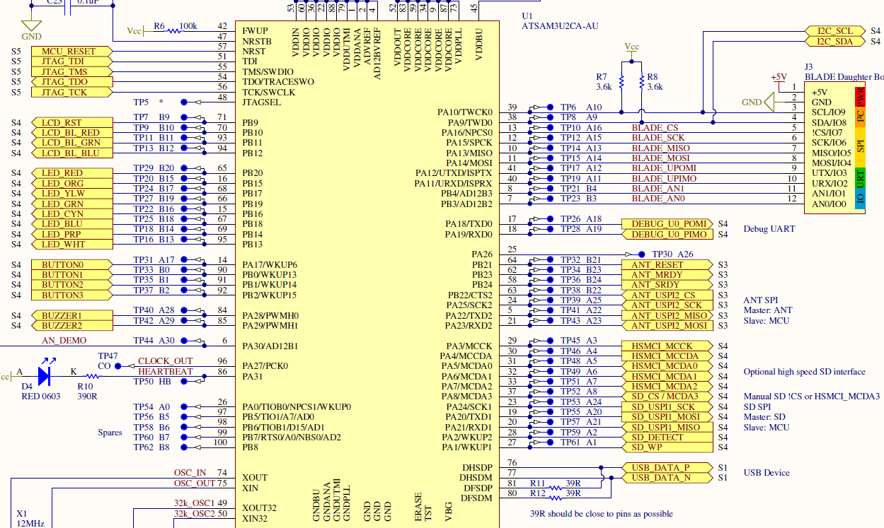
Notes:
Here’s the pinout of the MPG processor. You can see JTAG, LCD backlight, LEDs, buttons, buzzers, Blade (I2C, SPI, ADC, UART), Debug UART, ANT (SPI), HSMCI (SD card), USB

Slide 4
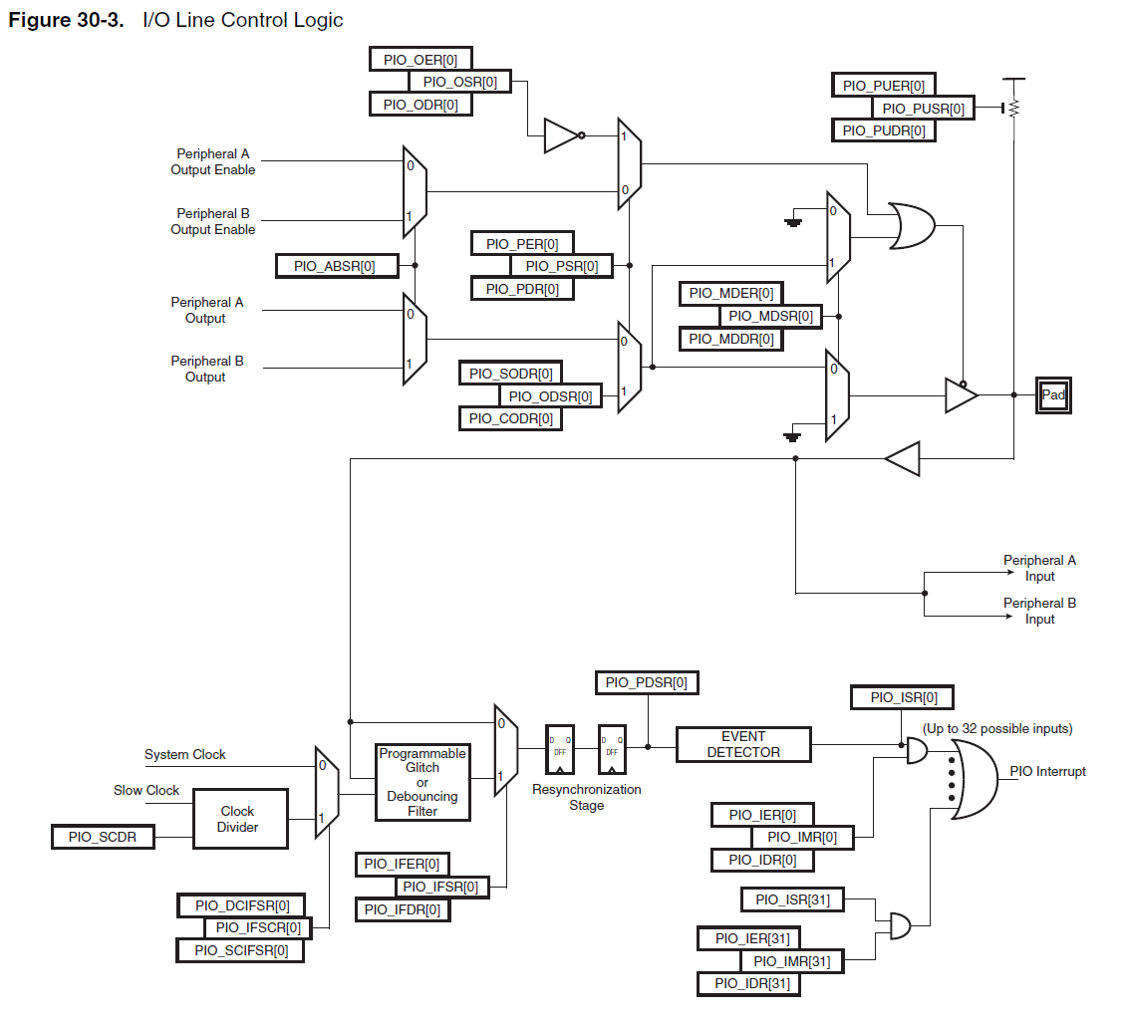
Notes:
Since we’re working with a general-purpose microcontroller, every pin needs to be configured for our application and circuit

Slide 5
Input/Output
Pull-up
Peripheral
Peripheral A/B Select
Set/Clear Output
xxER = Enable Register
xxSR = Status Register
xxDR = Disable Register
Notes:
The output sections. Note the common ER / SR / DR endings

Slide 6
xxER = Enable Register
xxSR = Status Register
xxDR = Disable Register
Status
Debounce/Glitch
Interrupt enable/mask/status
Notes:
Input sections

Slide 7
GPIO notes
Almost all processors default to “input” on power-up
This means that it won’t drive high/low and fry anything
Most processors have multiple “ports” (GPIOA, GPIOB, etc.) so they can have more than 32 pins
Some processors have a single “enable/disable/status” register, which means that you have to read/modify/write
Causes problems if the processor interrupts in the middle…
Our processor has separate registers so you can just write
You always have to refer to the processor’s reference manual
I always do the pin setup as the first thing in a project

Slide 8
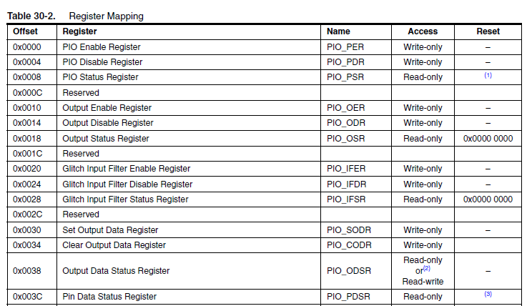
CPU Registers and Structs
(this isn’t even half of the GPIO registers)
Notes:
Embedded Programming is all about taking all of the CPU registers and hiding them away into APIs useful for your application, then building a program on top of that.

Slide 9
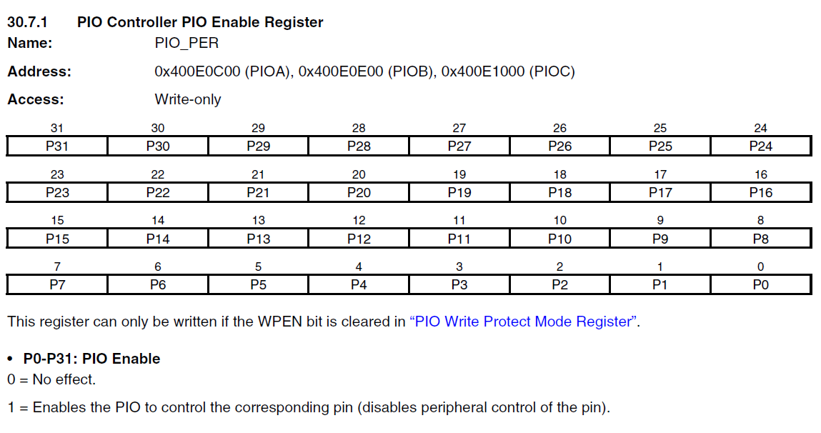
CPU Registers
ALL CPU registers are just values written to or read from special memory addresses!

Slide 10
CPU Registers
void GpioInit(void)
{
*((u32 *)0x400E0C00) = 0x84030107;
…
}
#define PIO_PERA (*(u32 *)0x400E0C00)
#define MPG_PERA (0x84030107)
void GpioInit(void)
{
PIO_PERA = MPG_PERA;
}
Notes:
Do you really want to go through defining all of these constants?
0x84030107 isn’t very clear … it’s like a “magic” number that would take a while to figure out and debug or correct if we ever had problems

Slide 11
Structs (revisited)
typedef struct
{
u16 lengthPixels;
u16 widthPixels;
} RECTANGLE;
u32 Area(RECTANGLE const *pRectangle)
{
return (u32)pRectangle->lengthPixels * (u32)pRectangle->widthPixels;
}
void ShrinkToSquare(RECTANGLE *pRectangle)
{
if (pRectangle->lengthPixels <= pRectangle->widthPixels)
pRectangle->widthPixels = pRectangle->lengthPixels;
else
pRectangle->lengthPixels = pRectangle->widthPixels;
}

Slide 12
Structs
typedef struct
{
u16 lengthPixels;
u16 widthPixels;
} RECTANGLE;
int main(void)
{
RECTANGLE rec = {2, 4};
u32 recArea = Area(&rec);
ShrinkToSquare(&rec);
u32 sqArea = Area(&rec);
…
}
u32 Area(RECTANGLE const *pRectangle)
{
return (u32)pRectangle->lengthPixels * (u32)pRectangle->widthPixels;
}
void ShrinkToSquare(RECTANGLE *pRectangle)
{
if (pRectangle->lengthPixels <= pRectangle->widthPixels)
pRectangle->widthPixels = pRectangle->lengthPixels;
else
pRectangle->lengthPixels = pRectangle->widthPixels;
}

Slide 13
Structs
0x0000 | lengthPixels
0x0001
0x0002 | widthPixels
0x0003
0x0004 | colorRgb
0x0005
0x0006
0x0007
0x0008
typedef struct
{
u16 lengthPixels;
u16 widthPixels;
u32 colorRgb;
} RECTANGLE;
Continuous block of memory

Slide 14
Structs
Address | name | offset (bytes)
0x4F02_0340 | lengthPixels | 0
0x4F02_0341
0x4F02_0342 | widthPixels | 2
0x4F02_0343
int main(void)
{
RECTANGLE rec = {2, 4};
u32 recArea = Area(&rec);
…
}
rec
0x4F02_0340
(&struct – just the address of the first member in the struct)
u32 Area(RECTANGLE const *pRectangle)
{
return (u32)pRectangle->lengthPixels * (u32)pRectangle->widthPixels;
}
-> offset
-> offset
Read the value at (0x4F02_0340 + offset 0)
Read the value at (0x4F02_0340 + offset 2)

Slide 15
CPU Registers and Structs
typedef struct {
u32 PIO_PER;
u32 PIO_PDR;
u32 PIO_PSR;
u32 Reserved0;
u32 PIO_OER;
u32 PIO_ODR;
u32 PIO_OSR;
u32 Reserved1;
u32 PIO_IFER;
u32 PIO_IFDR;
u32 PIO_IFSR;
u32 Reserved2;
u32 PIO_SODR;
u32 PIO_CODR;
u32 PIO_ODSR;
u32 PIO_PDSR;
} AT91S_PIO;
#include “AT91SAM3U4.h”
Notes:
Half of the registers for the PIO

Slide 16
CPU Registers and Structs…
typedef struct {
volatile unsigned int PIO_PER;
…
} AT91S_PIO;
#define AT91C_BASE_PIOA ((AT91S_PIO *)0x400E0C00)
#define AT91C_BASE_PIOB ((AT91S_PIO *)0x400E0E00)
void GpioInit(void)
{
AT91C_BASE_PIOA->PIO_PER = …;
}
Notes:
Is everyone with me? Have I lost anyone?
Still – let’s go a little further and see how we can make the value that is read/written clearer…

Slide 17

Register Bits
Port B, P14
Port B, P13
Port A, P17
Port B, P0

Slide 18
Register Bits
How would you make the button easier to use in code (besides 0x00000001)?
#define GPIO_BUTTON1 BIT0 // What about GPIOA vs GPIOB?
#define GPIOB_BUTTON1 BIT0 // Better… but still easy to mix up
#define GPIO_BUTTON1 GPIOB, BUTTON1 // Means 2 values for each pin…
PortA = {0 – 31} PortB = {32-63} enumerator! …

Slide 19
GPIO Enum
typedef enum
{
GPIO_PIN_PA0, // 0
GPIO_PIN_PA1, // 1
…
} GPIO_PIN;
void GpioSet(GPIO_PIN pin)
{
if (pin < 32)
GPIOA->PIO_SODR= (1 << pin);
else
GPIOB->PIO_SODR= (1 << (pin & 0x32));
}

Slide 20
GPIO Enum
static AT91S_PIO * const pGpioReg[] = { GPIOA, GPIOB };
#define GPIO_PIN_PORT(pin) (pin >> 5) // or divide by 32
#define GPIO_PIN_BIT(pin) (1UL << (pin & 31))
void GpioSet(GPIO_PIN pin)
{
u32 port = GPIO_PIN_PORT(pin);
u32 pinBit = GPIO_PIN_BIT(pin);
pGpioReg[port]->PIO_SODR = pinBit;
}

Slide 21
GPIO Enum
#define _BIT(n) (1U << (n))
GPIOA->PIO_OER = (_BIT(GPIO_LED_GREEN) | _BIT(GPIO_LED_RED) | …);
…
actual code use something called “x-macros” to simplify this step… too much to get into explaining today!

Slide 22
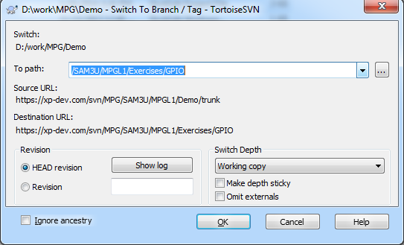
Your Turn!
void GpioClear(GPIO_PIN pin);
void GpioSetState(GPIO_PIN pin, bool pinState);
void GpioToggle(GPIO_PIN pin);
bool GpioIsSet(GPIO_PIN pin);
TortoiseSVN -> Switch:
/SAM3U/MPGL1/Exercises/GPIO

